Slide 1
Term Tuition Package
Guidelines and policies for singing tuition

Slide 2
Welcome
Kia ora koutou!
I count it a great privilege to be part of your singing journey and I’m excited to be working alongside you. Now that you have decided to delve into the wonders of developing your voice, let me present my guidelines and ideas that will help you get the most out of our time together.
Check out this link for more information: Letter of Introduction

Slide 4
What can you expect?

Slide 5
Inclusions
A term package will have up to 9 sessions which hopefully will be in my studio together but if that can’t happen then I have other options available.
Several services are included in this package such as: the purchase or provision of sheet music, purchase of backing tracks, photocopying and my research into songs, styles and keys that are suitable for your personal goals and stage of development.
Also included is the provision for alternative ways to spend the session if we can’t be in the room together.
I have found that blocks of time help to provide a more consistent and deeper learning experience. But your consistency of practice will also determine your how quickly you advance.
When you book and pay in full by week 3 you will receive the discounted rate otherwise it reverts to full rate.

Slide 6
Cancellation Policy
For cancellations please contact me at least 24 hours beforehand. All cancellations and no - shows must be paid for.
Booking a time slot is like paying rent and I am unable to rebook your slot.
I am also unable to make up lessons as my working timetable is full.
There would not be enough time in the week to provide substitute lessons for everyone. However, at my discretion I may be able to provide a makeup lesson under extenuating circumstances. Otherwise, if you are unable to make a lesson then the following alternatives will work…

Slide 7
Lesson Alternatives
Sometimes it’s just not possible to be in the room together due to things like sickness, restrictions, work commitments or transportation problems.
It is usually just not possible for me to be able to reschedule. So when this happens there are many other productive alternatives for your time slot.
This also creates an opportunity to round out your musical knowledge and experience and also include work on theory.
The following are some alternative lesson options. Please feel free to choose one when letting me know of your cancellation.
𝄞 You can record by video or audio singing a song and send it to me for my critique and recommendations
𝄞 Zoom or phone lesson at your usual time
𝄞 Have a discussion around voice topics, character development or a listening party by phone or online
𝄞 Spend that time doing a musical study, character study, technique study, journal your experiences, YouTube channel study, singer study, song study, theory study
𝄞 Record or write your discoveries in the above study area
𝄞 During your time I can research an interest topic for you, create a playlist on “who sang it best” or on a particular style or whatever information about music you would like to know
𝄞 I can find warm up exercises, sight singing apps, rhythm apps, documentaries or blogs

Slide 8
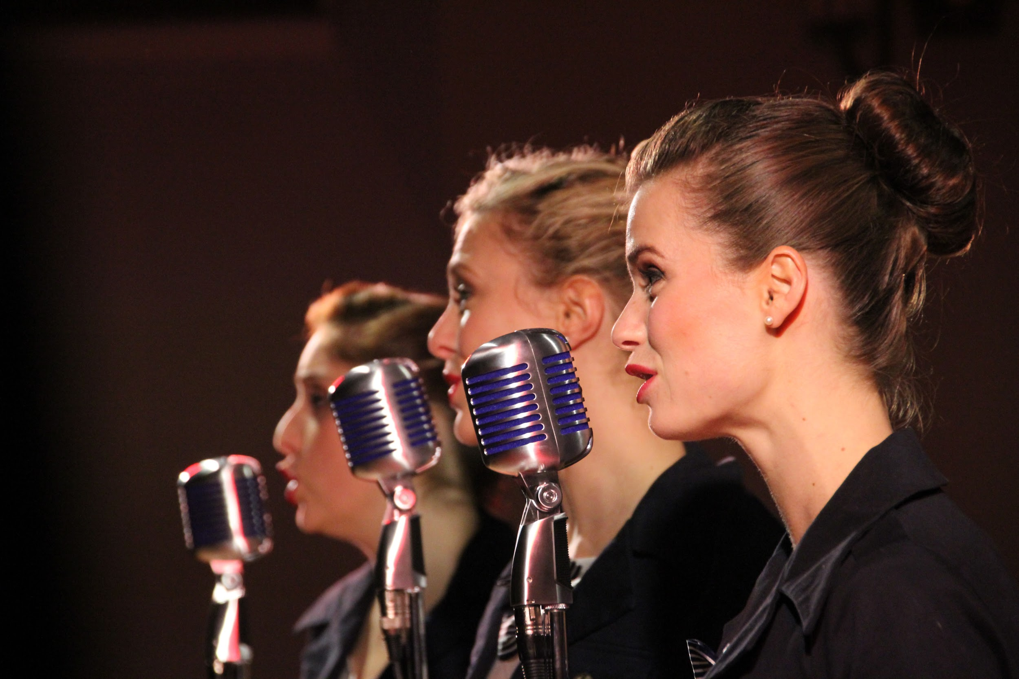
This is your singing journey
Set your goals and take the steps to get there.

Slide 9
Expectations
Songs Unlimited
empowering vocal freedom
PRACTICE! You will make the most progress if you use your voice everyday. Little and often work best for the voice and is achievable.
Turn up on time to sessions or let me know in advance so we can put one of the alternative plans in place.
Give yourself permission to blow it and don’t worry if it doesn’t sound exactly as you want it. Give everything a go and give it time to make sense.
It won’t happen overnight but it will happen!
Be real and honest. If something isn’t working for you, let me know so we can find a different way.
Take advantage of the opportunities.The spot is yours - make it count.

Slide 10
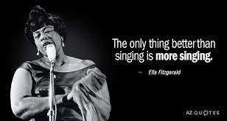
Always remember that and be kind to yourself and your journey.
Singing is for life and is meant to be fun!

Slide 11
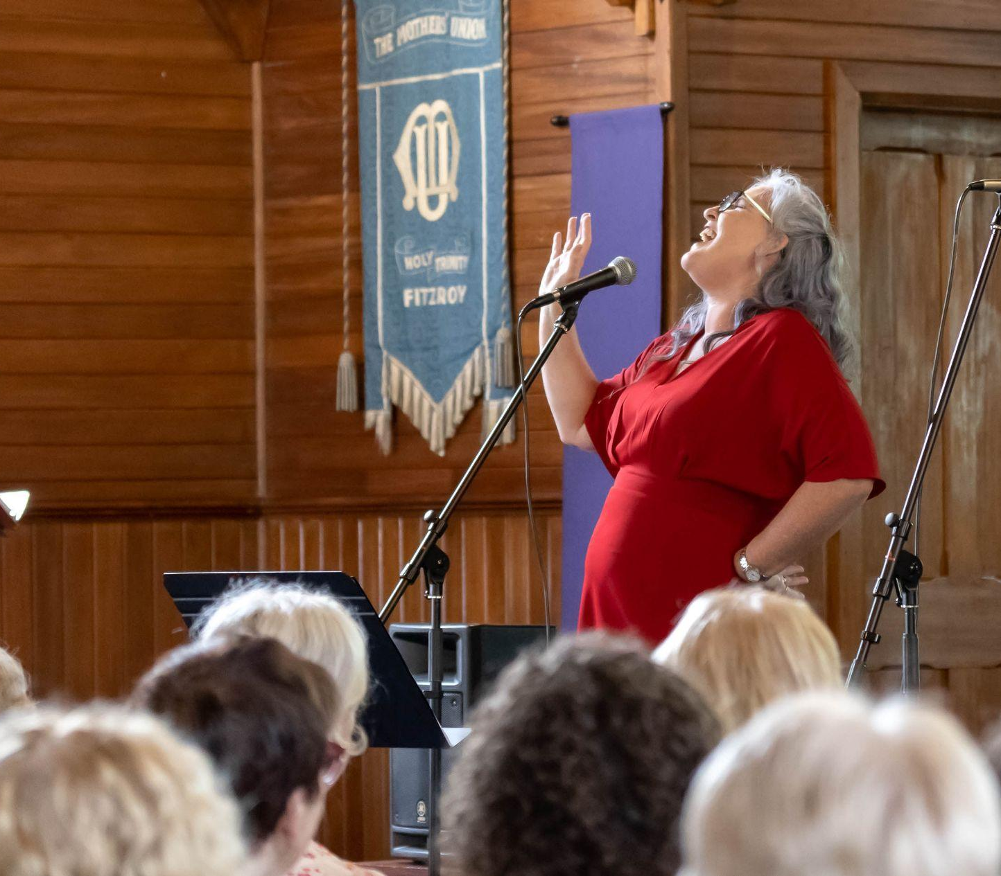
Nga mihi nui!
Contact Alyssa:
E: songsunlimited@icloud.com
M: 022 320 8607
W: www.songsunlimited.net
A: Songs Unlimited
9 Norwich Ave
New Plymouth

